Slide 1
Discrete Mathematics and Its Application 7th edition, 2001
Kenneth H. Rosen

Slide 2
Welcome to Discrete Mathematics Spring 2018
Instructor: Niu Shao Zhang

Slide 3
§3.3 Complexity of Algorithms
Section Summary
Time Complexity
Worst-Case Complexity
Algorithmic Paradigms(算法范例)
Understanding the Complexity of Algorithms

Slide 4
§3.3: Algorithmic Complexity
The algorithmic complexity of a computation is, most generally, a measure of how difficult it is to perform the computation.
That is, it measures some aspect of the cost of computation (in a general sense of “cost”).
Amount of resources required to do a computation.
Some of the most common complexity measures:
“Time” complexity: # of operations or steps required
“Space” complexity: # of memory bits req’d
Our focus

Slide 5
The Complexity of Algorithms
Given an algorithm, how efficient is this algorithm for solving a problem given input of a particular size? To answer this question, we ask:
How much time does this algorithm use to solve a problem?
How much computer memory does this algorithm use to solve a problem?
When we analyze the time the algorithm uses to solve the problem given input of a particular size, we are studying the time complexity of the algorithm.
When we analyze the computer memory the algorithm uses to solve the problem given input of a particular size, we are studying the space complexity of the algorithm.

Slide 6
The Complexity of Algorithms
In this course, we focus on time complexity. The space complexity of algorithms is studied in later courses.
We will measure time complexity in terms of the number of operations an algorithm uses and we will use big-O and big-Theta notation to estimate the time complexity.
We ignore implementation details (including the data structures used and both the hardware and software platforms) because it is extremely complicated to consider them.

Slide 7
Complexity Depends on Input
Most algorithms have different complexities for inputs of different sizes.
E.g. searching a long list typically takes more time than searching a short one.
Therefore, complexity is usually expressed as a function of the input length.
This function usually gives the complexity for the worst-case input of any given length.

Slide 8
Time Complexity
To analyze the time complexity of algorithms, we determine the number of operations, such as comparisons and arithmetic operations (addition, multiplication, etc.).
We will focus on the worst-case time complexity of an algorithm. This provides an upper bound on the number of operations an algorithm uses to solve a problem with input of a particular size.
It is usually much more difficult to determine the average case time complexity of an algorithm. This is the average number of operations an algorithm uses to solve a problem over all inputs of a particular size.

Slide 9
Complexity Analysis of Algorithms
Example: Describe the time complexity of the algorithm for finding the maximum element in a finite sequence.
procedure max(a₁, a₂, …., a_{n}: integers)
max := a₁
for i := 2 to n
if max < a_{i} then max := a_{i}
return max{max is the largest element}
Solution: Count the number of comparisons.
The max < a_{i} comparison is made n − 1 times.
Each time i is incremented, a test is made to see if i ≤ n.
One last comparison determines that i > n.
Exactly 2(n − 1) + 1 = 2n − 1 comparisons are made.
Hence, the time complexity of the algorithm is Θ(n).

Slide 10
Worst-Case Complexity of Linear Search
Example: Determine the time complexity of the linear search algorithm.
procedure linear search(x:integer,
a₁, a₂, …,a_{n}: distinct integers)
i := 1
while (i ≤ n and x ≠ a_{i})
i := i + 1
if i ≤ n then location := i
else location := 0
return location{location is the subscript of the term that equals x, or is 0 if x is not found}
Solution: Count the number of comparisons.
At each step two comparisons are made; i ≤ n and x ≠ a_{i} .
To end the loop, one comparison i ≤ n is made.
After the loop, one more i ≤ n comparison is made.
If x = a_{i} , 2i + 1 comparisons are used. If x is not on the list, 2n + 1 comparisons are made and then an additional comparison is used to exit the loop. So, in the worst case 2n + 2 comparisons are made. Hence, the complexity is Θ(n).

Slide 11
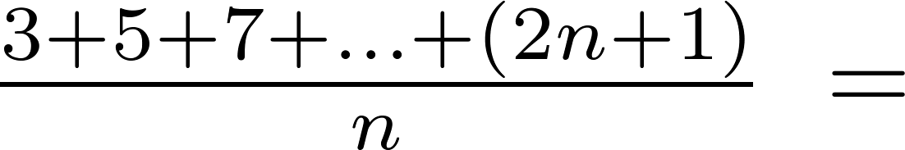
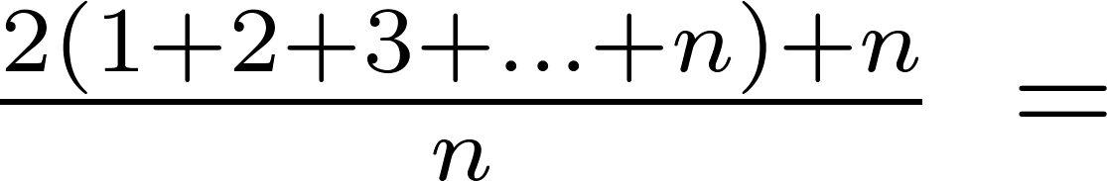
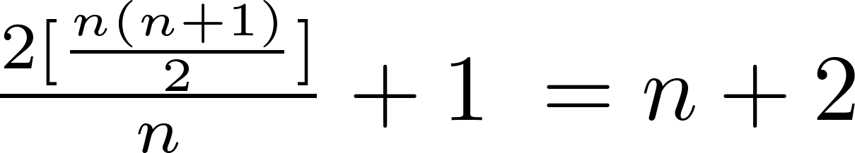
Average-Case Complexity of Linear Search
Example: Describe the average case performance of the linear search algorithm. (Although usually it is very difficult to determine average-case complexity, it is easy for linear search.)
Solution: Assume the element is in the list and that the possible positions are equally likely. By the argument on the previous slide, if x = a_{i} , the number of comparisons is 2i + 1.
Hence, the average-case complexity of linear search is Θ(n).

Slide 12
Worst-Case Complexity of Binary Search
Example: Describe the time complexity of binary search in terms of the number of comparisons used.
procedure binary search(x: integer, a₁,a₂,…, a_{n}: increasing integers)
i := 1 {i is the left endpoint of interval}
j := n {j is right endpoint of interval}
while i < j
m := ⌊(i + j)/2⌋
if x > a_{m} then i := m + 1
else j := m
if x = a_{i} then location := i
else location := 0
return location{location is the subscript i of the term a_{i} equal to x, or 0 if x is not found}
Solution: Assume (for simplicity) n = 2^{k} elements. Note that k = log n.
Two comparisons are made at each stage; i < j, and x > a_{m} .
At the first iteration the size of the list is 2^{k} and after the first iteration it is 2^{k-1}. Then 2^{k-2} and so on until the size of the list is 2¹ = 2.
At the last step, a comparison tells us that the size of the list is the size is 2⁰ = 1 and the element is compared with the single remaining element.
Hence, at most 2k + 2 = 2 log n + 2 comparisons are made.
Therefore, the time complexity is Θ (log n), better than linear search.

Slide 13
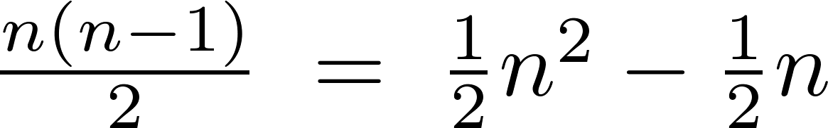
Worst-Case Complexity of Bubble Sort
Example: What is the worst-case complexity of bubble sort in terms of the number of comparisons made?
procedure bubblesort(a₁,…,a_{n}: real numbers
with n ≥ 2)
for i := 1 to n− 1
for j := 1 to n − i
if a_{j} >a_{j+1} then interchange a_{j} and a_{j+1}
{a₁,…, a_{n} is now in increasing order}
Solution: A sequence of n−1 passes is made through the list. On each pass n − i comparisons are made.
The worst-case complexity of bubble sort is Θ(n²) since .

Slide 14
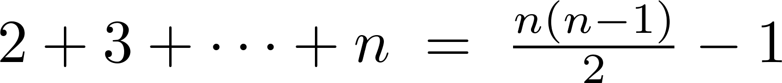
Worst-Case Complexity of Insertion Sort
Example: What is the worst-case complexity of insertion sort in terms of the number of comparisons made?
procedure insertion sort(a₁,…,a_{n}:
real numbers with n ≥ 2)
for j := 2 to n
i := 1
while a_{j} > a_{i}
i := i + 1
m := a_{j}
for k := 0 to j − i − 1
a_{j-k} := a_{j-k-1}
a_{i} := m
Solution: The total number of comparisons are:
Therefore the complexity is Θ(n²).

Slide 15
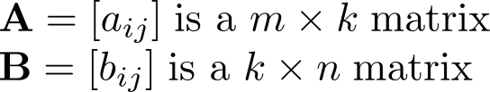

Matrix Multiplication Algorithm
The definition for matrix multiplication can be expressed as an algorithm; C = A B where C is an m $×$ n matrix that is the product of the m $×$ k matrix A and the k $×$ n matrix B.
This algorithm carries out matrix multiplication based on its definition.
procedure matrix multiplication(A,B: matrices)
for i := 1 to m
for j := 1 to n
c_{ij} := 0
for q := 1 to k
c_{ij} := c_{ij} + a_{iq} b_{qj}
return C{C = [c_{ij}] is the product of A and B}

Slide 16

Complexity of Matrix Multiplication
Example: How many additions of integers and multiplications of integers are used by the matrix multiplication algorithm to multiply two n n matrices.
Solution: There are n² entries in the product. Finding each entry requires n multiplications and n − 1 additions. Hence, n³ multiplications and n²(n − 1) additions are used.
Hence, the complexity of matrix multiplication is O(n³).

Slide 17
Boolean Product Algorithm
The definition of Boolean product of zero-one matrices can also be converted to an algorithm.
procedure Boolean product(A,B: zero-one matrices)
for i := 1 to m
for j := 1 to n
c_{ij} := 0
for q := 1 to k
c_{ij} := c_{ij} ∨ (a_{iq} ∧ b_{qj})
return C{C = [c_{ij}] is the Boolean product of A and B}

Slide 18
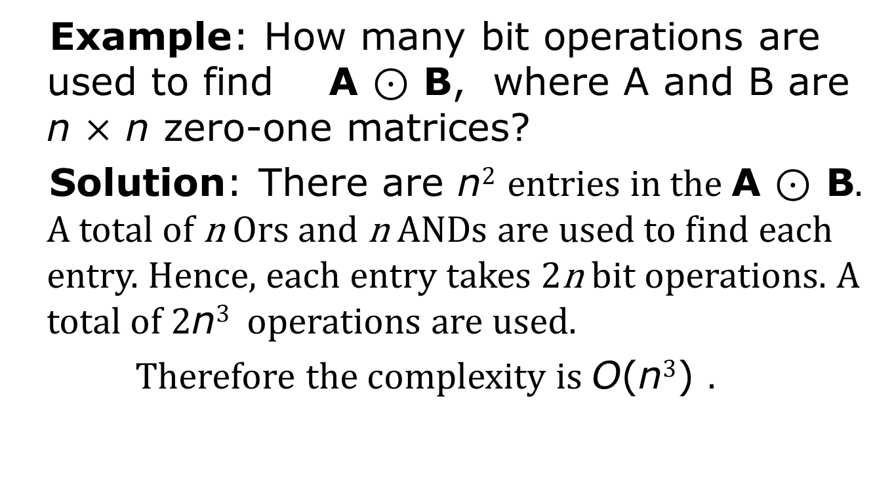
Complexity of Boolean Product Algorithm
Example: How many bit operations are used to find A ⊙ B, where A and B are n $×$ n zero-one matrices?
Solution: There are n² entries in the A ⊙ B. A total of n Ors and n ANDs are used to find each entry. Hence, each entry takes 2n bit operations. A total of 2n³ operations are used.
Therefore the complexity is O(n³) .

Slide 19
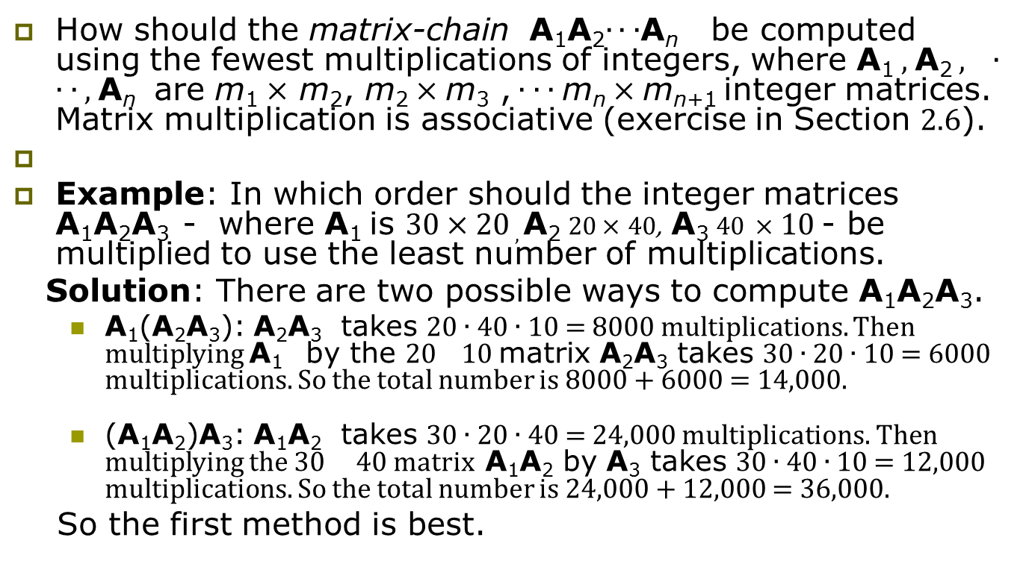
Matrix-Chain Multiplication
How should the matrix-chain A₁A₂∙ ∙ ∙A_{n} be computed using the fewest multiplications of integers, where A₁ , A₂ , ∙ ∙ ∙ , A_{n} are m₁ $×$ m₂, m₂ $×$ m₃ , ∙ ∙ ∙ m_{n} $×$ m_{n+1} integer matrices. Matrix multiplication is associative (exercise in Section 2.6).
Example: In which order should the integer matrices A₁A₂A₃ - where A₁ is 30 $×$ 20 , A₂ 20 $×$ 40, A₃ 40 $×$ 10 - be multiplied to use the least number of multiplications.
Solution: There are two possible ways to compute A₁A₂A₃.
A₁(A₂A₃): A₂A₃ takes 20 ∙ 40 ∙ 10 = 8000 multiplications. Then multiplying A₁ by the 20 10 matrix A₂A₃ takes 30 ∙ 20 ∙ 10 = 6000 multiplications. So the total number is 8000 + 6000 = 14,000.
(A₁A₂)A₃: A₁A₂ takes 30 ∙ 20 ∙ 40 = 24,000 multiplications. Then multiplying the 30 40 matrix A₁A₂ by A₃ takes 30 ∙ 40 ∙ 10 = 12,000 multiplications. So the total number is 24,000 + 12,000 = 36,000.
So the first method is best.
An efficient algorithm for finding the best order for matrix-chain multiplication can be based on the algorithmic paradigm known as dynamic programming. (see Ex. 57 in Section 8.1)

Slide 20
Algorithmic Paradigms
An algorithmic paradigm is a general approach based on a particular concept for constructing algorithms to solve a variety of problems.
Greedy algorithms were introduced in Section 3.1.
We discuss brute-force algorithms(蛮力算法) in this section.

Slide 21
Brute-Force Algorithms
A brute-force algorithm is solved in the most straightforward manner, without taking advantage of any ideas that can make the algorithm more efficient.
Brute-force algorithms we have previously seen are sequential search, bubble sort, and insertion sort.

Slide 22
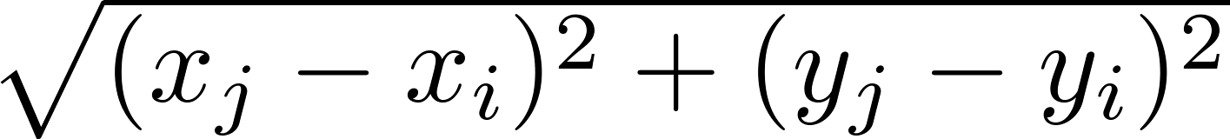
Computing the Closest Pair of Points by Brute-Force
Example: Construct a brute-force algorithm for finding the closest pair of points in a set of n points in the plane and provide a worst-case estimate of the number of arithmetic operations.
Solution: Recall that the distance between (x_{i},y_{i}) and (x_{j}, y_{j}) is . A brute-force algorithm simply computes the distance between all pairs of points and picks the pair with the smallest distance.
Note: There is no need to compute the square root, since the square of the distance between two points is smallest when the distance is smallest.
Continued →

Slide 23
Computing the Closest Pair of Points by Brute-Force
Algorithm for finding the closest pair in a set of n points.
The algorithm loops through n(n −1)/2 pairs of points, computes the value (x_{j} − x_{i})² + (y_{j} − y_{i})² and compares it with the minimum, etc. So, the algorithm uses Θ(n²) arithmetic and comparison operations.
We will develop an algorithm with O(log n) worst-case complexity in Section 8.3.
procedure closest pair((x₁, y₁), (x₂, y₂), … ,(x_{n}, y_{n}): x_{i}, y_{i} real numbers)
min = ∞
for i := 1 to n
for j := 1 to i
if (x_{j} − x_{i})² + (y_{j} − y_{i})² < min
then min := (x_{j} − x_{i})² + (y_{j} − y_{i})²
closest pair := (x_{i}, y_{i}), (x_{j}, y_{j})
return closest pair

Slide 24
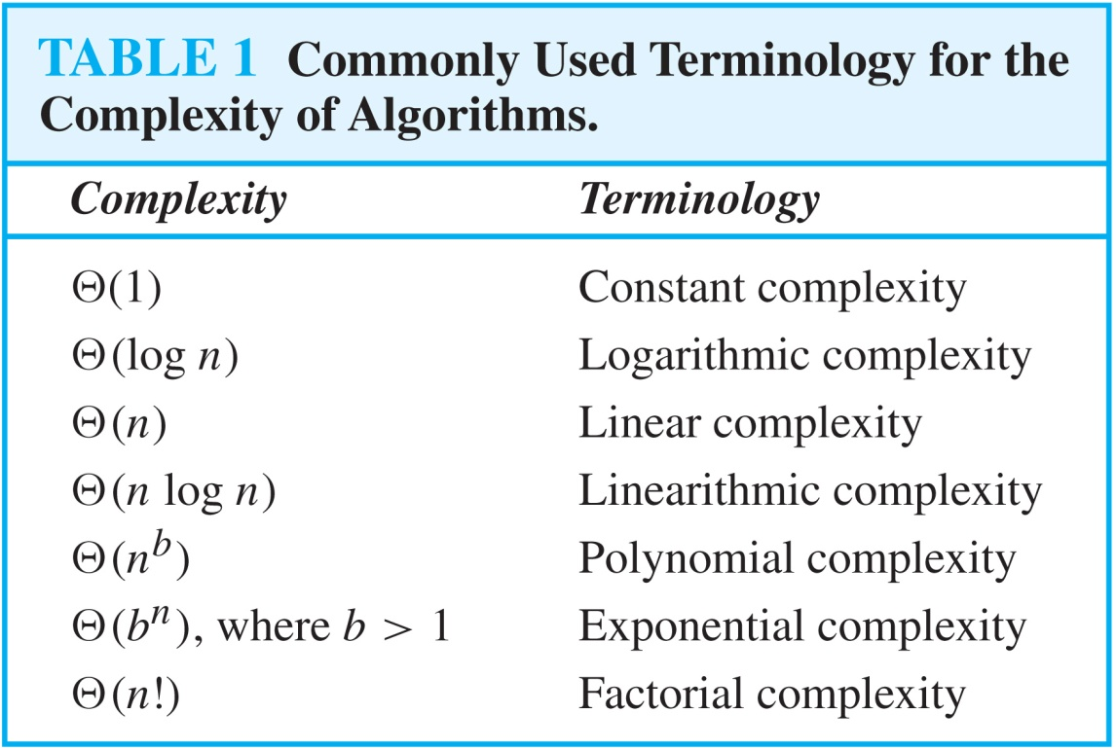
Understanding the Complexity of Algorithms

Slide 25
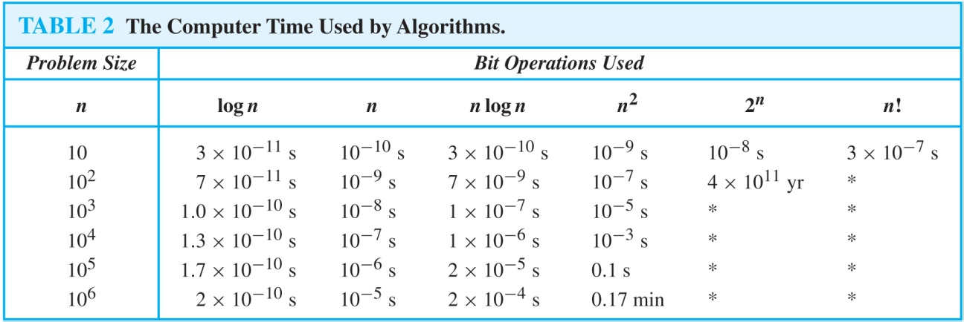
Understanding the Complexity of Algorithms
Times of more than 10¹⁰⁰ years are indicated with an *.

Slide 26
Example : Linear Search
procedure linear search (x: integer, a₁, a₂, …, a_{n}: distinct integers) i := 1 t₁ while (i ≤ n ∧ x ≠ a_{i}) t₂ i := i + 1 t₃ if i ≤ n then location := i t₄ else location := 0 t₅ return location t₆
_{简洁估计}

Slide 27
Linear search analysis
Worst case time complexity order:
Best case:
Average case, if item is present:

Slide 28
Example: Binary Search
procedure binary search (x:integer, a₁, a₂, …, a_{n}: distinct integers, sorted smallest to largest) i := 1 j := n while i<j begin m := ⎣(i+j)/2⎦ if x>a_{m} then i := m+1 else j := m end if x = a_{i} then location := i else location := 0 return location
Key question: How many loop iterations?
Θ(1)
Θ(1)
Θ(1)

Slide 29
Binary search analysis
Suppose that n is a power of 2, i.e., ∃k: n=2^{k}.
Original range from i=1 to j=n contains n items.
Each iteration: Size j−i+1 of range is cut in ~half.
Loop terminates when size of range is 1=2⁰ (i=j).
Therefore, the number of iterations is: k = log₂n = Θ(log₂ n)= Θ(log n)
Even for n≠2^{k} (not an integral power of 2), time complexity is still Θ(log₂ n) = Θ(log n).

Slide 32
Complexity of Problems
Tractable Problem（易解问题）: There exists a polynomial time algorithm to solve this problem. These problems are said to belong to the Class P（P类）.
Intractable Problem （难解问题） : There does not exist a polynomial time algorithm to solve this problem
Unsolvable Problem （不可解问题） : No algorithm exists to solve this problem, e.g., halting problem.

Slide 33
Tractable vs. intractable
A problem or algorithm with at most polynomial time complexity is considered tractable (or feasible). P is the set of all tractable problems.
A problem or algorithm that has complexity greater than polynomial is considered intractable (or infeasible).

Slide 34
Complexity of Problems
Class NP （NP类） : Solution can be checked in polynomial time. But no polynomial time algorithm has been found for finding a solution to problems in this class.
NP Complete Class （NP完全类） : If you find a polynomial time algorithm for one member of the class, it can be used to solve all the problems in the class.
P问题是可以在多项式时间内被确定机(通常意义的计算机)解决的问题.
NP(Non-Deterministic Polynomial, 非确定多项式)问题,是指可以在多项式时间内被非确定机(他可以猜,他总是能猜到最能满足你需要的那种选择,如果你让他解决n皇后问题,他只要猜n次就能完成----每次都是那么幸运)解决的问题.

Slide 35
Computer Time Examples
(1.25 bytes)
(125 kB)
Assume time = 1 ns (10⁻⁹ second) per op, problem size = n bits, and #ops is a function of n, as shown.

Slide 36

P Versus NP Problem
Stephen Cook
(Born 1939)
The P versus NP problem asks whether the class P = NP? Are there problems whose solutions can be checked in polynomial time, but can not be solved in polynomial time?
Note that just because no one has found a polynomial time algorithm is different from showing that the problem can not be solved by a polynomial time algorithm.
If a polynomial time algorithm for any of the problems in the NP complete class were found, then that algorithm could be used to obtain a polynomial time algorithm for every problem in the NP complete class.

Slide 37
P vs. NP
NP is the set of problems for which there exists a tractable algorithm for checking a proposed solution to tell if it is correct.
We know that P⊆NP, but the most famous unproven conjecture in computer science is that this inclusion is proper.
i.e., that P⊂NP rather than P=NP.
Whoever first proves this will be famous!
(or disproves it!)

Slide 38
P Versus NP Problem
Stephen Cook
(Born 1939)
It is generally believed that P≠NP since no one has been able to find a polynomial time algorithm for any of the problems in the NP complete class.
The problem of P versus NP remains one of the most famous unsolved problems in mathematics (including theoretical computer science). The Clay Mathematics Institute has offered a prize of $1,000,000 for a solution.
一个著名的问题----千禧难题之首,P问题是否等于NP问题,也即是否所有在非确定机上多项式可解的问题都能在确定机上用多项式时间求解.

Slide 39
Key Things to Know
Definitions of algorithmic complexity, time complexity, worst-case time complexity.
Names of specific orders of growth of complexity.
How to analyze the worst case, best case, or average case order of growth of time complexity for simple algorithms.

Slide 40
Homework
§3.3
36

